Slide 1
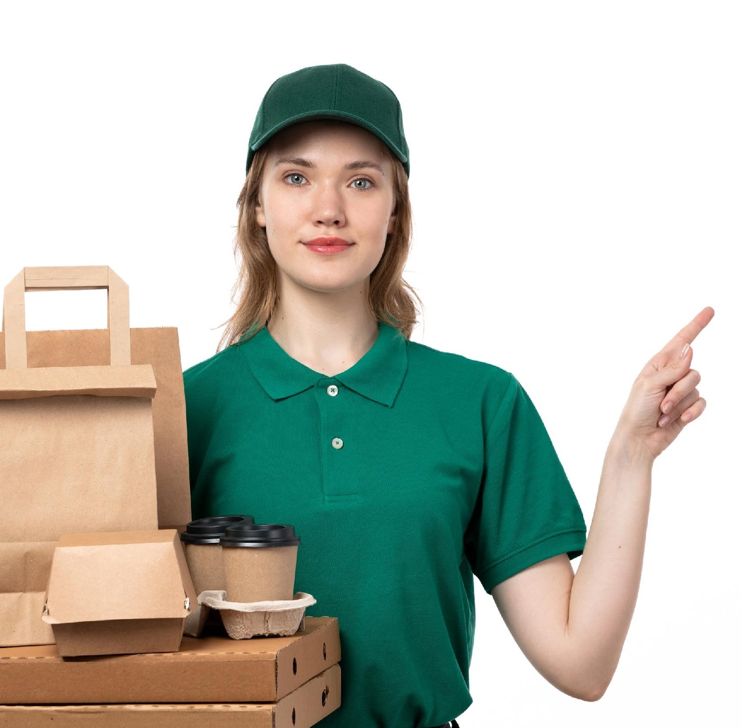
Food Delivery Analysis
Time taken by the Drivers to pick up the orders from the restaurant.

Slide 2

Agenda
Why?
How?
Delivery Companies working in this area
Day to Day Activities of Data Scientist
Required Skills
Relevant courses offered at CU Boulder
Visualization - Time Taken by Driver to Arrive at the Restaurant
Conclusion

Slide 3

Why?
Customer Satisfaction
Food Quality
Delayed Delivery
Operational Inefficiency
Increased Cost
Competitive Advantage

Slide 4

How?
01. Predictive Analysis
02. Route Optimization
Data Science can play a significant role in addressing the problem of delayed food pick-up by providing valuable insights and tools for optimization. Here are a few solutions
03. Real Time Monitoring
04. Driver Performance Analysis
05. Machine Learning and Automation
06. A/B Testing

Slide 5





Delivery Companies Working in this area

Slide 6


Day to Day activities of Data Scientist
Here are some day to day activities of data scientist in this field:
DD
Data Collection and Preprocessing
Model Developing
Experimentation and A/B Testing
Exploratory Data Analysis
Model Evaluation
Documentation
Data Visualization and Learning
Real Time Monitoring
Problem Solving

Slide 7


Required Skills
Data Analytics and Visualization
Machine Learning
Big Data Analytics
Optimization Techniques
Geographic Information Systems
Time Series Analysis

Slide 8

Relevant Courses offered at
CU Boulder
CSCI 6502: Big Data Analytics
CSCI 5622: Machine learning
GEOG 5003: Elements of Geographic Information Systems
CSCI 5454: Design and Analysis of Algorithm

Slide 9
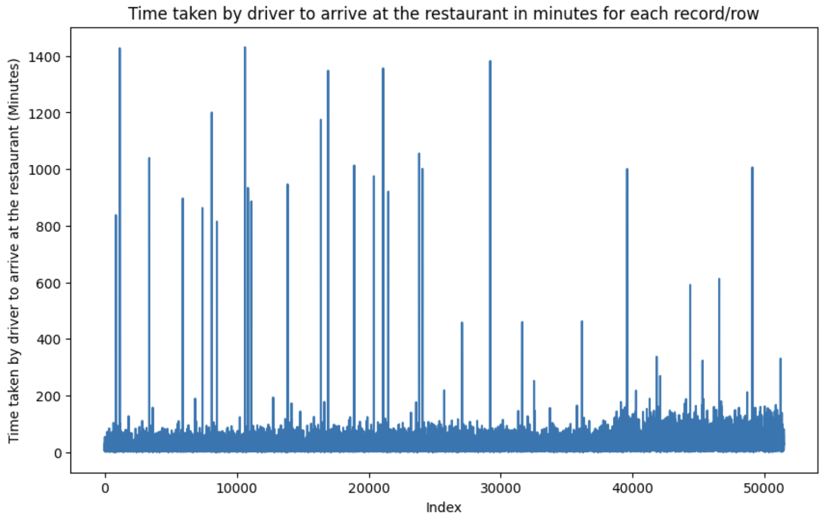
Time Taken by Driver
to Arrive at the Restaurant

Slide 10
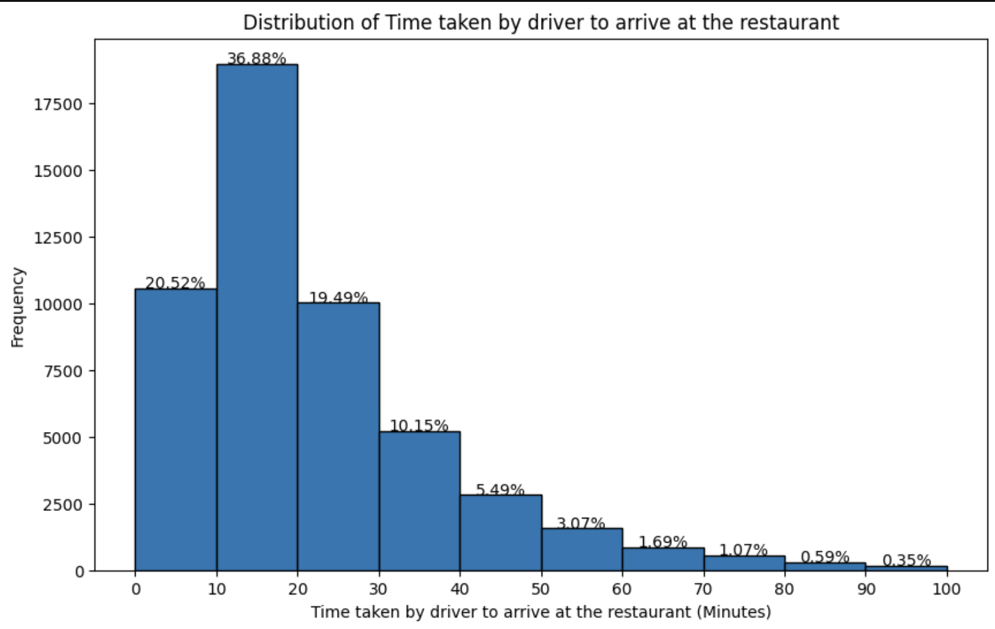
Conclusion
from the graph, we can depict that approximately 23% of the time drivers take more than 30 mins to arrive at the restaurant to collect the order.

Slide 11


